Slide 1

COAL MINE SAFETY USING IOT
Submitted by:
ECE-D, Batch No: 14
M.Surya Chandrika 19P31A04M4
C. Kalyani 19P31A04K5
A. Swathi 19P31A04J5
M. Sandeep Kumar 19P31A04M2
Under the Guidance of
Ms. K.M.V.V.L.Manasa, M.Tech
Assistant Professor
Department of ECE
ACET(P3)

Slide 2

CONTENTS
Aditya College of Engineering and Technology
ABSTRACT
OBJECTIVE
INTRODUCTION
PROBLEM STATEMENT
EXISTING SYSTEM
PROPOSED SYSTEM
BLOCK DIAGRAM
WORKING
COMPONENTS
ADVANTAGES,DISADVANTAGES & APPLICATIONS
CONCLUSION & FUTURE SCOPE
REFERENCES

Slide 3
ABSTRACT
Aditya College of Engineering and Technology
Generally, people working in mining areas, face many risk factors. In order to safe guard the people working inside the mine its environmental parameters should be monitored. Machine to machine (commonly abbreviated as M2M) refers to direct communication between devices using any communications channel, including wired and wireless.
Machine to machine communication can include industrial instrumentation, enabling a sensor or meter to communicate the data it records (such as temperature, inventory level, etc.) to application software that can use it (for example, adjusting an industrial process based on temperature or placing orders to replenish inventory).
IOT based wireless communication system is used for the interface between two Machines or two hardware units. Using these types of system we can easily move machine from one place to other without any rerouting of hardware cables.

Slide 4
OBJECTIVE
Aditya College of Engineering and Technology
Machine to machine (commonly abbreviated as M2M) refers to direct communication between devices using any communications channel, including wired and wireless.
Machine to machine communication can include coal mining industries, enabling a sensor or meter to communicate the data it records (such as temperature,gases,etc.) to application software that can use it (for example, adjusting an industrial process based on temperature or placing orders to replenish inventory).
Internet of Things (IoT) based wireless communication system is used for the interface between two Machines or two hardware units.

Slide 5
INTRODUCTION
Aditya College of Engineering and Technology
Machine-to-Machine (M2M) communication is a form of data communication that involves one or more entities that do not necessarily require human interaction or intervention in the process of communication.
In underground mining, there are various factors due to which miners tumble down and lose consciousness. To overcome this issue, the system gives a crisis alarm to the supervisor using the IOT module if an individual falls somewhere by any reason.
15-10-2022 IV ECE-D,BATCH N0.14

Slide 6
LITERATURE SURVEY
Aditya College of Engineering and Technology
1. Shashank Kumar, the term of Industry 4.0 (German Industry 4.0), commonly recognized nowadays, occurred in the public domain in 2011 at the Hanover Trade Fair as the name for the common initiative of the representatives of business, policy and science promoting the idea of strengthening the competitiveness of the German industry (Müller et al., 2018; Rao and Prasad, 2018).
2. Beata Ślusarczyk., Paper selected for this section has discussed the production process and some advanced design of shop floor in the manufacturing industry by using cyber-physical system (CPS) and smart object.
3. Bozena Gajdzik 1, Sandra Grabowska 2, and Sebastian Saniuk 3, The first step of literature review was used the bibliometric analysis [36]. The following keywords were selected in the bibliographic analysis: "Pathway to Industry 4.0“.
4. Priyanka Verma, Priyanka Verma, Jyoti Kushwaha, Cyber-Physical Systems: The Cyber-Physical System (CPS) concept is defined as a technique where artificial and biological systems for processing, information exchange and feedback processing are integrated into physical and cyberspace (Bagheri et al. al. 2015).
5. COAL MINE SAFETY MONITORING ANDALERTING SYSTEM [5] Authors:S. R. Deokar et al Miner’s health and life is vulnerable to several critical issues, which includes not only the working environment, but also the after effect of it.

Slide 7
PROBLEM STATEMENT
Aditya College of Engineering and Technology
Today, the safety of miner workers is a significant challenge. Miner’s health and life are helpless against a few basic issues, which incorporates the working environment, yet in addition its delayed consequence.
To extent profitability and diminish the expense of mining alongside the thought of the safety of miners, a creative and innovative methodology is required.

Slide 8
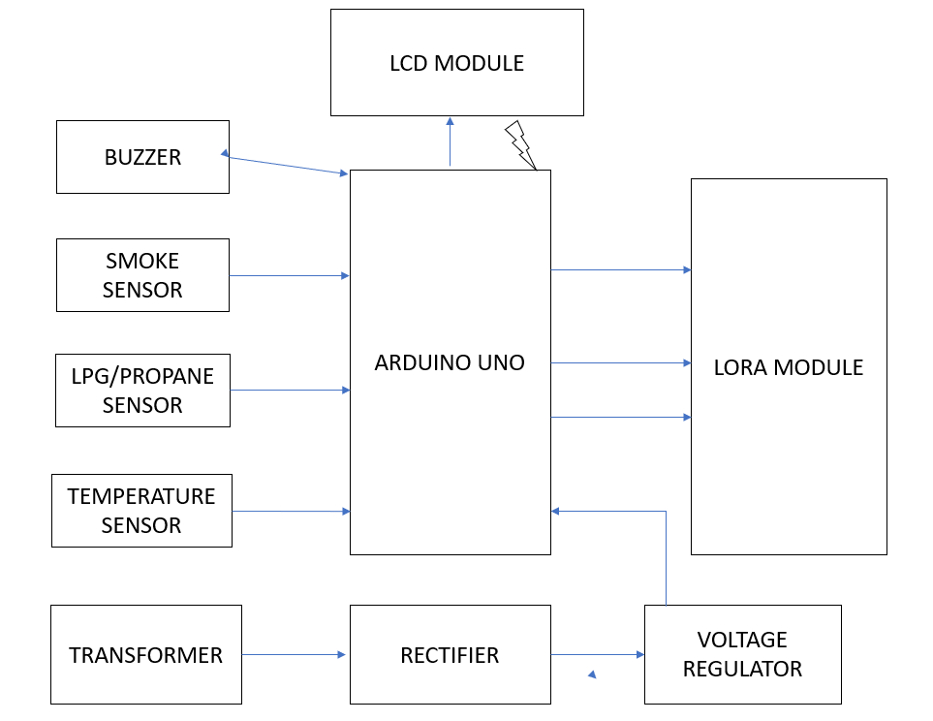
Aditya College of Engineering and Technology EXISTING SYSTEM

Slide 9
EXISTING SYSTEM
Aditya College of Engineering and Technology
LORA based wireless communication system is used for the interface between two Machines or two hardware units. Using these types of system we can easily move machine from one place to other without any rerouting of hardware cables.
In this proposed system, we have demonstrated wireless machine to machine communication between two hardware units; first one is Sensor Unit and second is Control Unit.
Sensor unit uploads real-time data over LORA Module of 433MHz. Control unit retrieves these data from same server and switches On/Off the output device accordingly.
Both this devices are communicated using Radio Frequency Network.

Slide 10
PROPOSED SYSTEM
Aditya College of Engineering and Technology
In this proposed system, we have designed a Innovative solution for communication between Sensor unit and Control unit using IoT Technology.
Using this method, sensor data are send to cloud server using Blynk IoT Cloud platform and Control unit receives this data from IoT Server and process this data using Arduino controller board.
This type of system can be modify easily by simply changing the programming section.

Slide 11
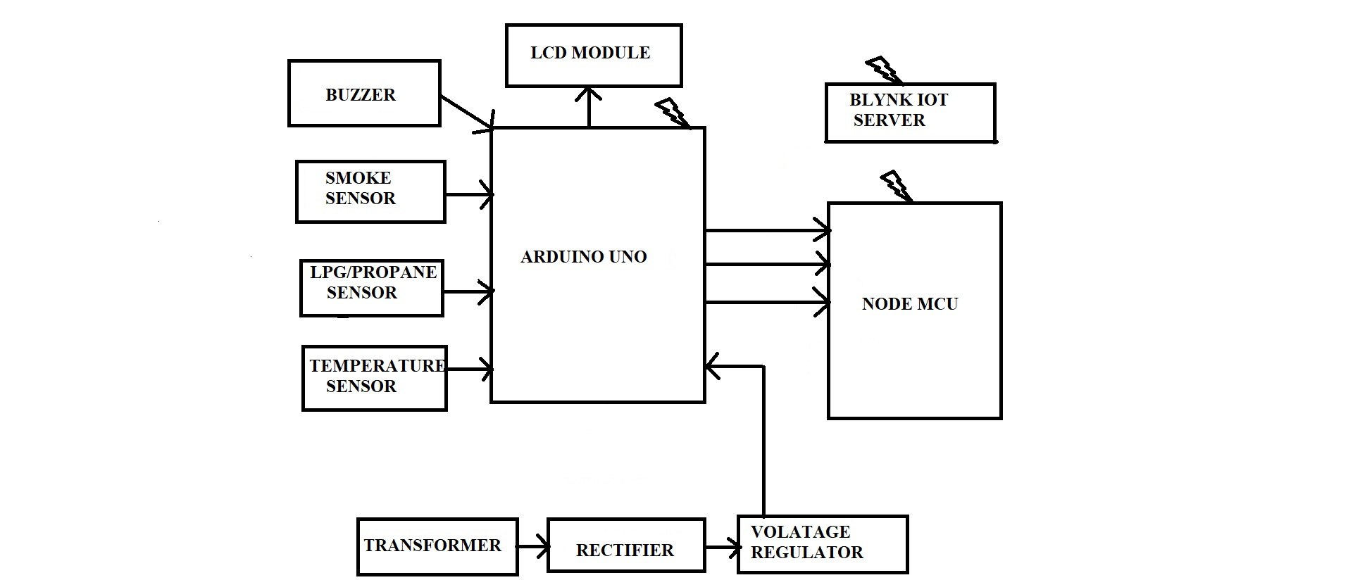
BLOCK DIAGRAM Fig a.Sensor Unit
Aditya college Of Engineering And Technology

Slide 12
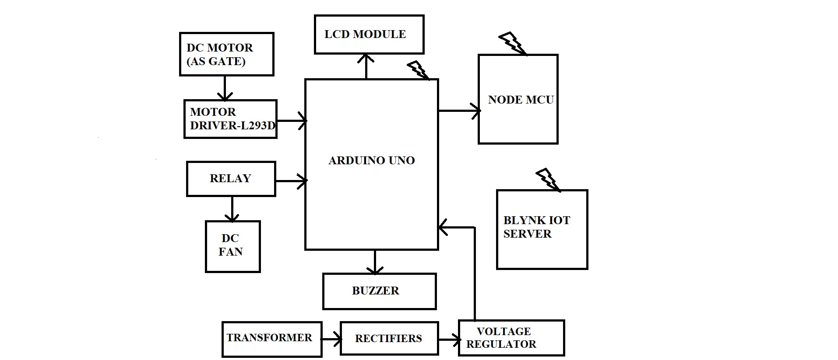
BLOCK DIAGRAM Fig b.Control unit
Aditya college Of Engineering And Technology
FFI

Slide 13
WORKING
Aditya College of Engineering and Technology
Sensor unit is designed using Arduino Nano Microcontroller, Node MCU, LCD Module Smoke Sensor, LPG Sensor and Temperature as main components. Sensor Unit update the Gas and Temperature Data over IoT server using Wi-Fi module.
Control unit is designed using Node MCU, LCD Module, Relay Module, Buzzer Module, Motor Driver and DC Motor as main components. Control Unit Retrieves this data from IoT Server and Control the Load (Such as DC Motor, Buzzer and Fan) according to the Predefined values in the Microcontroller. Both units Communicates between each other using Internet Technology.
If the Sensor Parameter crosses the Threshold level than high alert buzzer sound will be produced. If Temperature Sensor Parameter Increased than Fan will be switched on and if LPG or Smoke Sensor Parameter increases than DC Gear Motor (as Gate) will be opened.

Slide 14
WORKING
Aditya College of Engineering and Technology
This Machine to machine Interface system can be operated from anywhere in the World wirelessly. LCD Module are interfaced to Digital Pin of Arduino 2,3,4,5,6,7. Control devices such as DC Motor and Buzzer are connected to 8,9 Pins. Sensor modules are connected to Analog Pins of Arduino and Wifi Module are connected to 10,11 Pins of Arduino.
The power supply setup of the system contains a step down transformer of 230/12V, used to step down the voltage to 12VAC. To convert it to DC, a bridge rectifier is used. 7805 voltage regulator is used regulate 12V Dc to +5V that will be needed for microcontroller and other components operation. Filter Capacitor are used to remove ripple from DC Voltages.

Slide 15

Aditya College of Engineering and Technology
COMPONENTS
ARDUINO UNO
The Arduino Uno is a microcontroller board based on a removable, dual-inline-package.
The board is equipped with sets of digital and analog input/output (I/O) pins that may be interfaced to various expansion boards and other circuits.
The board has 14 digital I/O pins, 6 analog I/O pins, and is programmable with the Arduino IDE(Integrated Development Environment), via a type B USB cable.
It has one 5v output pin and one 3.3v output pin, it also contains three ground pins.
ARDUINO UNO

Slide 16
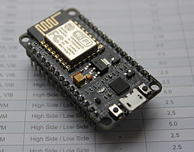
NODE MCU MICROCONTROLLER
Aditya College of Engineering and Technology
Node MCU is an open source LUA based firmware developed for ESP8266 wifi chip. By exploring functionality with ESP8266 chip, Node MCU firmware comes with ESP8266 Development board/kit i.e. Node MCU Development board.
The ESP8266 is a low-cost Wi-Fi chip developed by Espressif Systems with TCP/IP protocol.
Node MCU Dev Kit has Arduino like Analog (i.e. A0) and Digital (D0-D8) pins on its board.

Slide 17
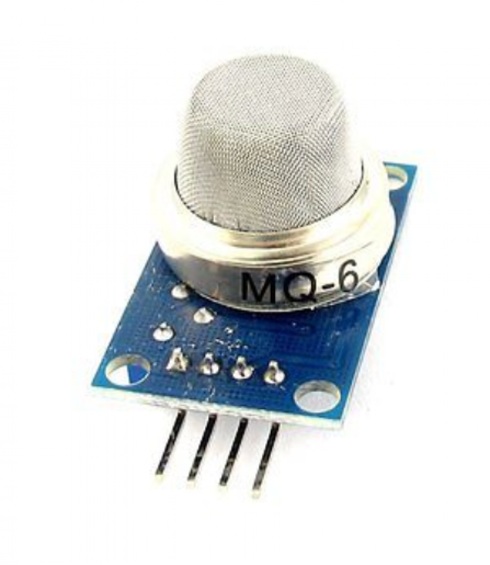
Aditya College of Engineering and Technology
GAS SENSOR
MQ2 Gas sensor is a Metal Oxide Semiconductor (MOS) type Gas Sensor mainly used to detect gases like Methane, Butane, LPG, Smoke, etc.
It is also known as Chemiresistors as the gas detection is based on the change of resistance of the sensing material when the Gas comes in to contact
Operating Voltage is +5V
Analog output voltage: 0V to 5V
Digital Output Voltage: 0V or 5V (TTL Logic)
The Sensitivity of Digital pin can be varied using the potentiometer
PROPANE SENSOR

Slide 18
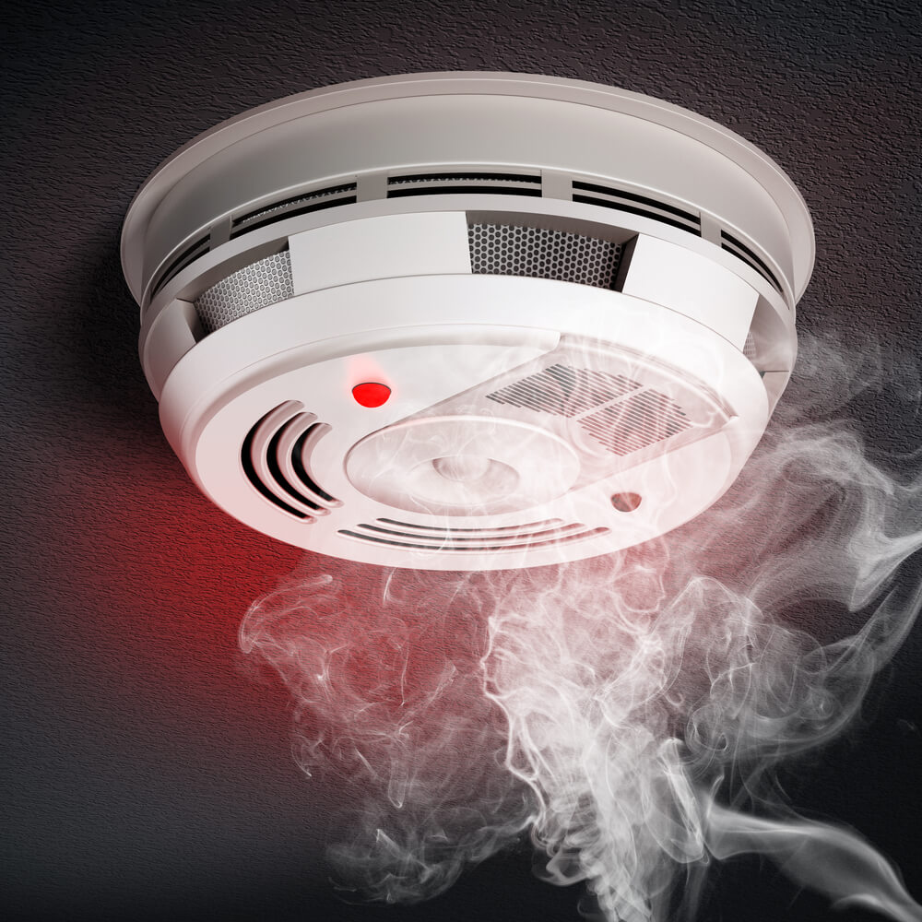
SMOKE SENSOR
Aditya College of Engineering and Technology
A smoke sensor is a device that senses smoke, typically as an indication of fire.
The analog Smoke/LPG/CO Gas Sensor(MQ2) module utilizes an MQ-2 as the sensitive component and has a protection resistor and an adjustable resistor. Power Consumption – 0.5ma Sound Level – 85 at 3m Wireless Frequency – 868.6625 Mhz

Slide 19
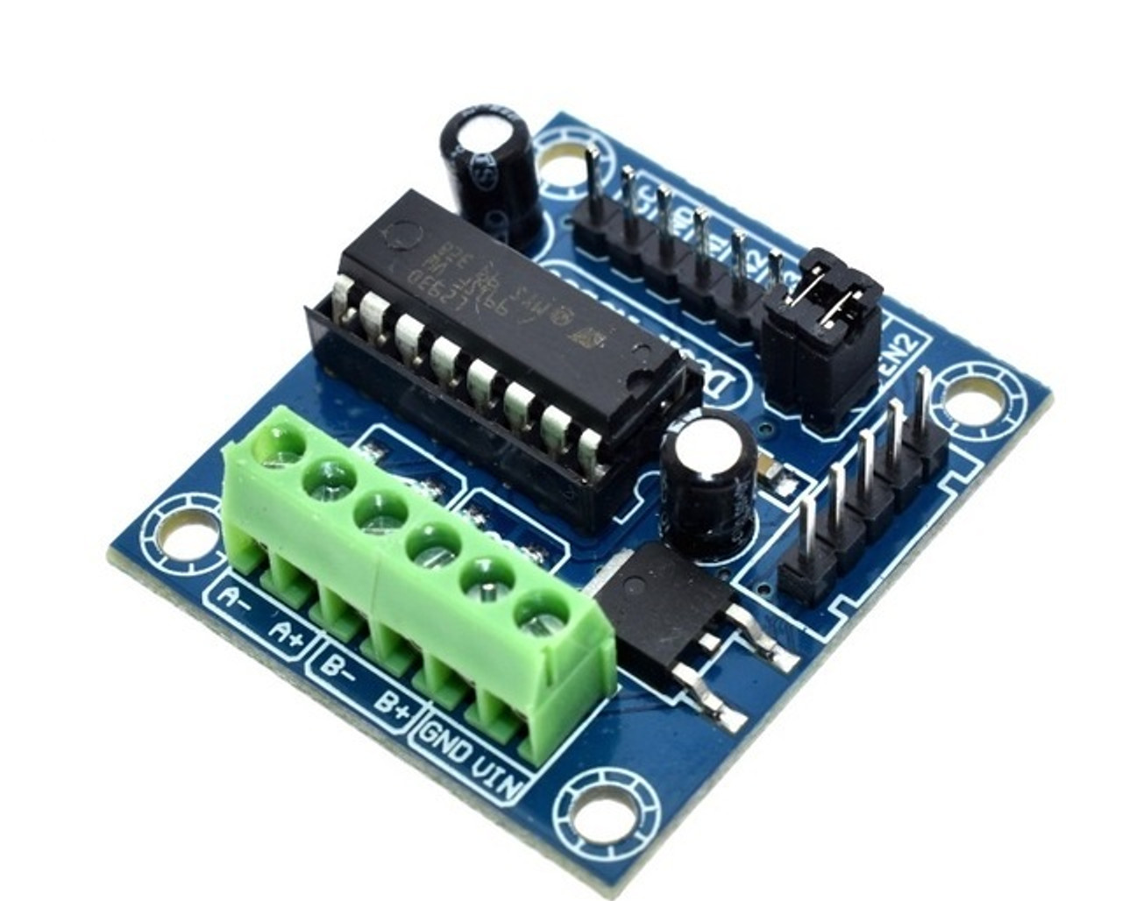
MOTOR DRIVER-L293D
Aditya College of Engineering and Technology
L293D Motor Driver Module L293D is a basic motor driver integrated chip (IC) that enables us to drive a DC motor in either direction and also control the speed of the motor.
The L293D is a 16 pin IC, with 8 pins on each side, allowing us to control the motor. It means that we can use a single L293D to run up to two DC motors.
Supply Voltage Range 12V
36V Output current capability per driver
Separate Input-logic supply
Pulsed Current 1.2-A Per Driver

Slide 20
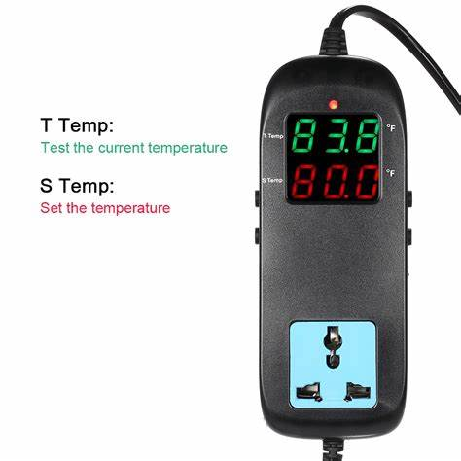
DIGITAL TEMPERATURE SENSOR
Aditya College of Engineering and Technology
A digital temperature is a sensor, which provides 9-bit temperature readings.
Digital temperature sensors offer excellent precise accuracy, these are designed to read from 0°C to 70°C and it is possible to achieve ±0.5°C accuracy.

Slide 21
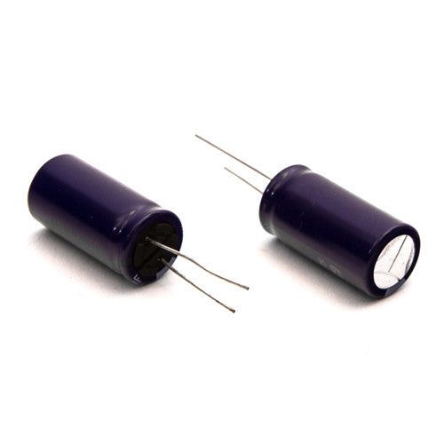
FILTER CAPCITOR
Aditya College of Engineering and Technology
A filter capacitor is a capacitor which filters out a certain frequency or range of frequencies from a circuit.
Filter Capacitor are used to remove ripple from DC Voltages.
Usually capacitors filter out very low frequency signals. These are signals that are very close to 0Hz in frequency value. These are also referred to as DC signals.

Slide 22
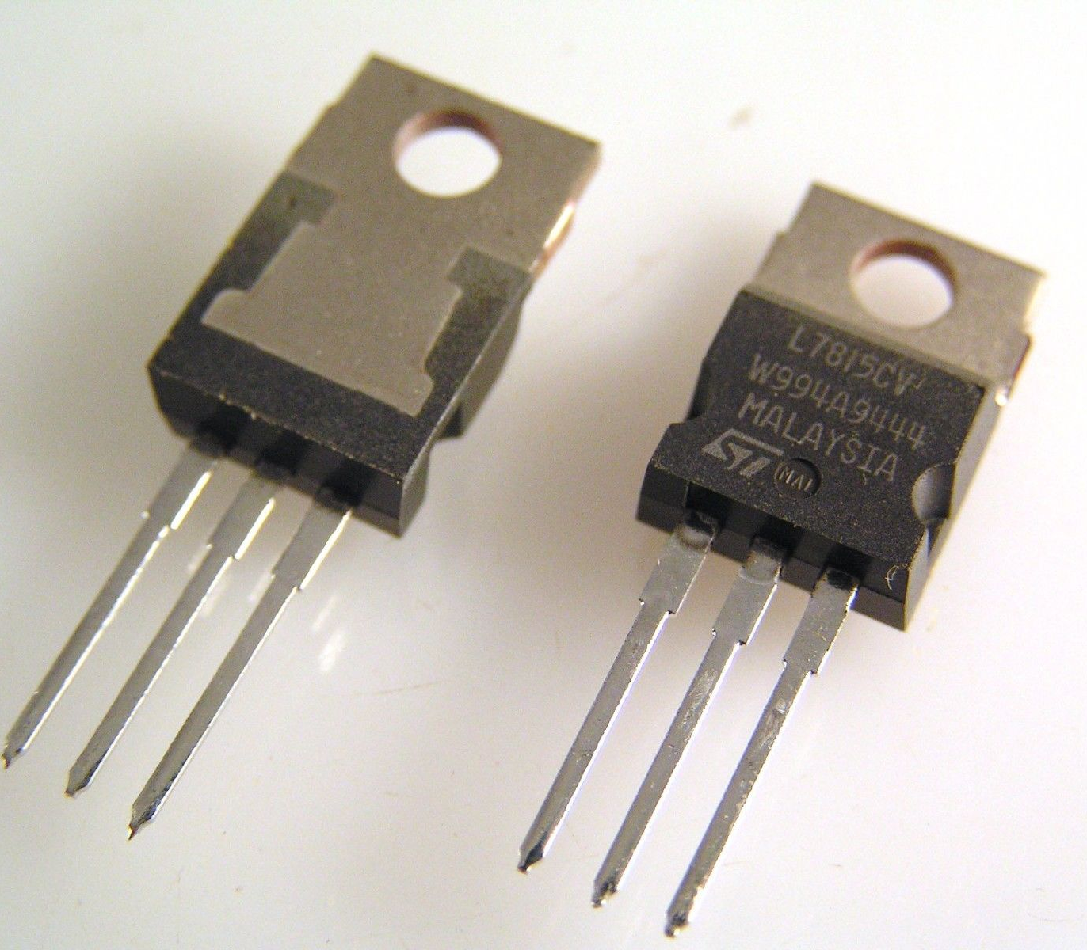
VOLTAGE REGULATOR
Aditya College of Engineering and Technology
A voltage regulator is a system designed to automatically maintain a constant voltage.
7805 voltage regulator is used regulate 12V Dc to +5V that will be needed for microcontroller and other components operation
5V Positive Voltage Regulator
Minimum Input Voltage is 7V
Maximum Input Voltage is 25V
Operating current(I_{Q}) is 5mA

Slide 23
Aditya College of Engineering and Technology
ADVANTAGES
M2M communication is supported by cellular networks either directly or through gateway.
It is easy to roll out and maintain.
It is available with fixed and mobile networks both indoors and outdoors.
It offers higher range, minimum latency, higher throughput and consume less energy.
It enables communication of smart devices without any human intervention.
The security and privacy issues in IoT networks are resolved by using M2M
Communication facility.
Large protection, data collection and data processing is possible

Slide 24
Aditya College of Engineering and Technology
DISADVANTAGES
High cost: Implementing an IoT system for coal mine safety can be expensive due to the high cost of sensors, data storage, and communication infrastructure.
Technical complexity: IoT systems require a high level of technical expertise to design, implement, and maintain. Therefore, coal mine operators need to have the necessary resources and skills to handle the technical complexity of an IoT system.
Maintenance and repair: IoT devices used in coal mines may require frequent maintenance and repair due to the harsh mining environment and the wear and tear of the devices.
Dependence on technology: Over-reliance on technology can make workers complacent and reduce their safety awareness, as they may assume that technology can always prevent accidents.

Slide 25
APPLICATIONS There are several applications of IoT (Internet of Things) technology for coal mine safety: Environmental monitoring: IoT sensors can be used to monitor various environmental factors such as temperature, humidity, gas levels, and air quality. This data can be collected and analyzed in real-time to identify potential safety hazards and take preventive measures. Communication and collaboration: IoT devices can be used to establish communication between workers and management, allowing for faster response times in case of emergencies or safety incidents. Worker safety monitoring: IoT devices can be used to monitor the location and condition of workers in the mine. This can help to identify potential safety hazards and ensure that workers are safe and accounted for in case of emergencies.
Aditya College of Engineering and Technology

Slide 26
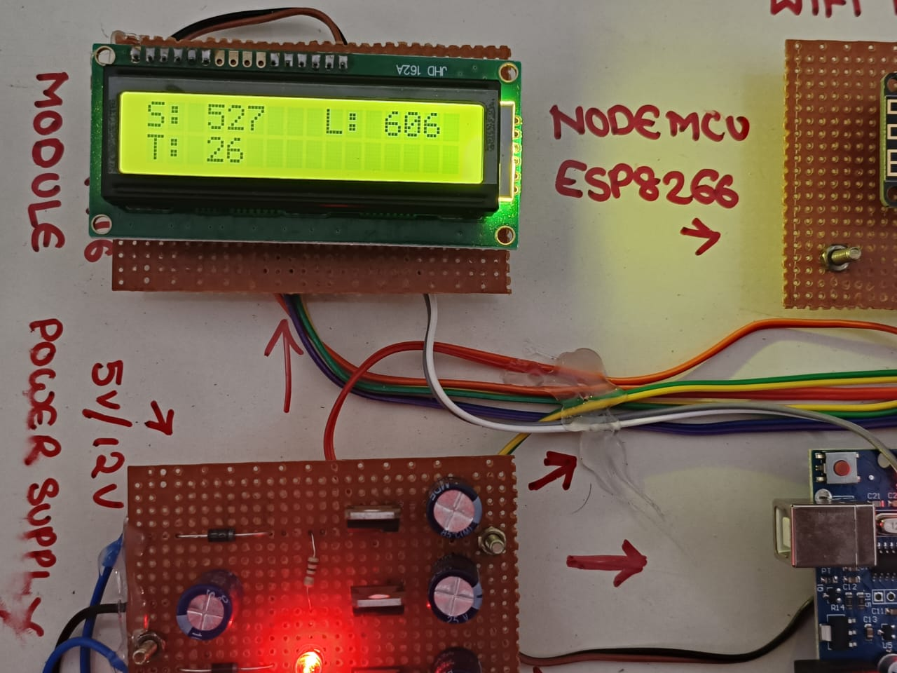
OUTPUT The coal mine safety system is implemented using smoke sensors, temperature sensors, gas sensors for obtaining environmental conditions. A smart alert system is implemented for the safety of mineworkers by alerting them at the right time to escape from the mining environment in case of any accidents. This system constantly observes the coal mine and alerts the worker and the authorized person from the ground station by using IOT technology. The environment of the mineworkers have continuously updated in the IoT web page. The system is cost-effective. Hence the proposed system reduces the death rate and disease alerts for the workers in the mining industry.
Aditya College of Engineering and Technology

Slide 27
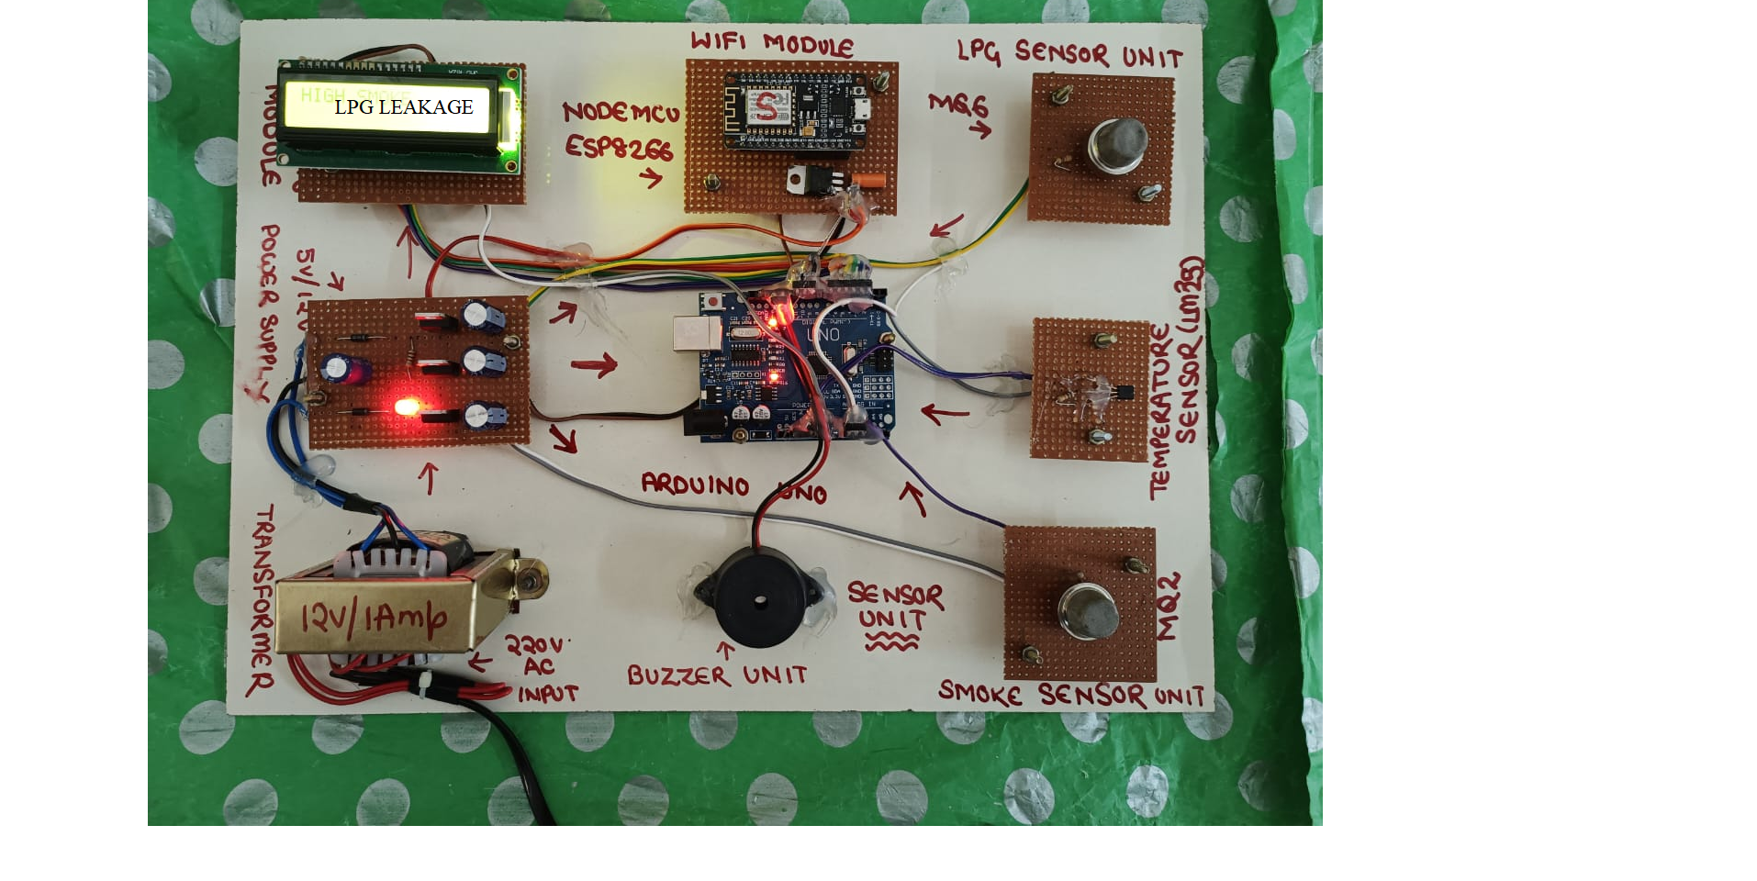
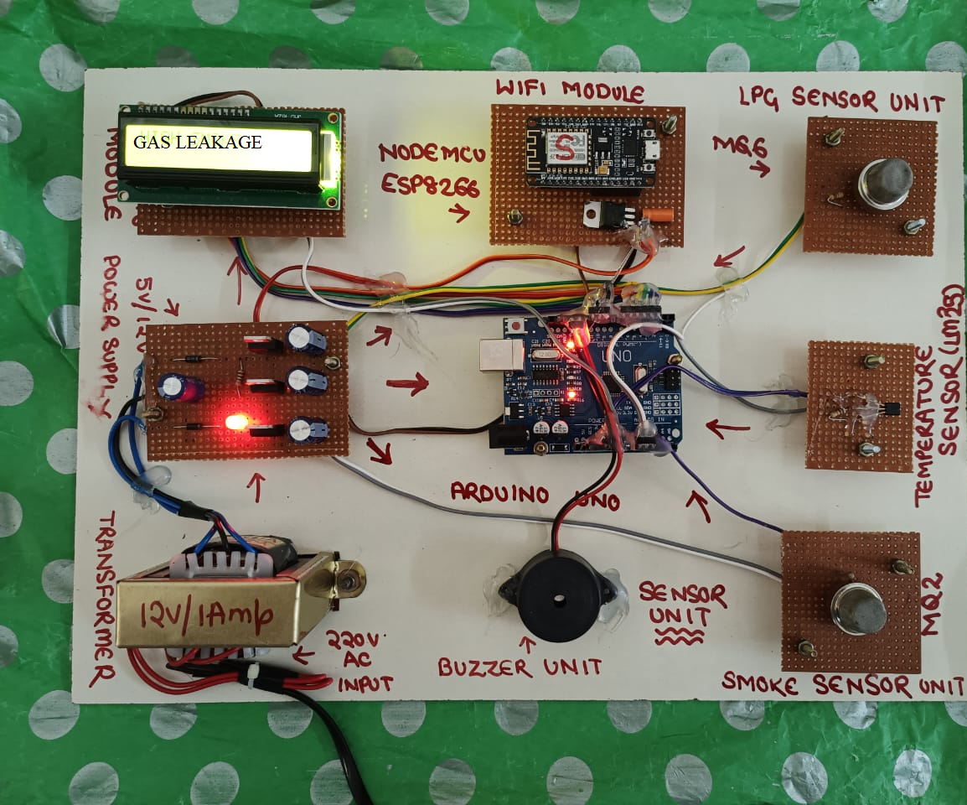

Slide 28


Slide 29
CONCLUSION & FUTURE SCOPE
Aditya College of Engineering and Technology
The protection of working machinery is the main goal of the implementation of safety measures in port operations, where sensors and switches are used to provide safety for personnel. With current technology, it is impossible to control and observe the port personnel due to their high levels of movement and risk. The environment of the mineworkers have continuously updated in the IoT web page. The system is cost-effective. Hence the proposed system reduces the death rate and disease alerts for the workers in the mining industry.
With the developing developments future work of this experimentation may incorporate, greater improvement of the framework by utilizing other progressed sensors for checking the underground Dangers. Likewise, every one of the underground tasks can be completed from the beginning.

Slide 30
REFERENCES
Aditya College of Engineering and Technology
[1] Abdulrahman A, Abdulmalik A S , Mansour A , et al , May (2016). Ultra Wideband Indoor Positioning Technologies : Analysis and Recent Advances[J]. Sensors, vol.16, no.5, pp.707-743.
[2] Al-Haija Q A, Alfarran I, Alabdullah A, et al, Sep (2019). Design and on-field testing of wireless sensor network-based air quality monitoring system[J]. JITCE (Journal of Information Technology and Computer Engineering), vol.3, no.2, pp.54-59.
[3] Akkas M A, Jun (2018). Using wireless underground sensor networks for mine and miner safety[J]. WirelessNetworks, vol.24, no.1, pp.17- 26.
[4] R. K. Kodali and K. S. Mahesh, ”Low cost ambient monitoring using ESP8266,” 2016 2nd International Conference on Contemporary Computing and Informatics (IC3I), Greater Noida, India, 2016, pp. 779-782, doi: 10.1109/IC3I.2016.7918788.

Slide 31
Aditya College of Engineering and Technology
THANK
YOU

